Slide 1





















Pengenalan kepada Sistem eProfiling
Lets start

Slide 2

PENGENALAN PROJEK NKEA
Membangunkan Profil Kompetensi Pengajar TVET Kepada Agensi Di Bawah Program Pembangunan Pengajar Kemahiran (PPK) Tenaga Pengajar Dan Pegawai Latihan Vokasional Bagi Rancangan Malaysia Ke-11
TAKLIMAT PROJEK PROFILING
eProfiling
PROFIL KOMPETENSI PENGAJAR TVET
RIGHT TRAINER. RIGHT TRAINING. RIGHT TIME
Notes:
Overview of the National Key Economic Areas
The 12 National Key Economic Areas (NKEAs) comprise selected sectors of economic opportunity for the private sector which will drive Malaysia towards high-income status and global competitiveness. While Malaysia already has a competitive advantage in some sectors and the potential to carve a niche in others, the NKEAs underscore Malaysia’s targeted approach to achieving sustainable economic growth.
NKEAs receive prioritised Government support due to their potential to enhance GNI¹, although the Government also remains committed to developing non-NKEA sectors. It is important to note that while the NKEAs were chosen to lead the country’s economic growth, non-NKEAs will continue to play an important role in Malaysia’s transformation. This is as the non-NKEAs are projected to benefit from multiplier effects created through the implementation of the NKEAs, signifying the catalytic nature of the NKEAs.
The implementation of NKEAs is overseen by the relevant Ministry /Ministries, which coordinate, monitor and track the progress of the sectors. To realise private sector-driven growth, each NKEA offers private sector involvement and investment opportunities through Entry Point Projects (EPPs).
To-date, 149 EPPs have been announced from a list of 159 identified EPPs. These EPPs guide the development of the industry or sector and were formulated through public and private sector consultations during labs held in 2010.
The NKEAs also identify Business Opportunities (BOs) which can be developed to achieve future growth.

Slide 3

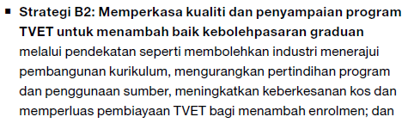

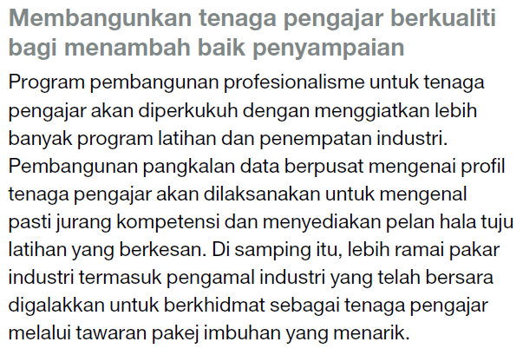
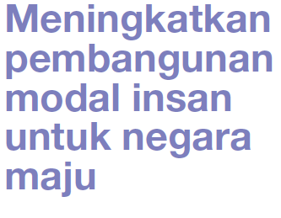
TAKLIMAT PROJEK PROFILING
eProfiling
PROFIL KOMPETENSI PENGAJAR TVET
RIGHT TRAINER. RIGHT TRAINING. RIGHT TIME

Slide 4
KENAPA PROFIL KOMPETENSI PENGAJAR TVET?
Merancang latihan pengajar kemahiran bertauliah dengan keperluan melebihi
30,000 orang menjelang tahun 2020.
Sebagai mekanisma untuk mengukur keperluan latihan pengajar secara berstruktur dengan kos latihan yang efektif.
Mewujudkan sistem pangkalan data berkaitan profil kompetensi pengajar
TVET secara sistematik.
TAKLIMAT PROJEK PROFILING
PROFIL PENGAJAR
Maklumat Am Pengajar
Tugas Semasa Pengajar
Komponen Kompetensi Pengajar
  Vokasional / Profesional
  Pedagogikal & Sosial
  Pengurusan
PROFIL KOMPETENSI PENGAJAR TVET
eProfiling
PROFIL KOMPETENSI PENGAJAR TVET
RIGHT TRAINER. RIGHT TRAINING. RIGHT TIME

Slide 5
TUJUAN PROJEK
Mengenalpasti jurang kompetensi pengajar TVET dengan kaedah yang sistematik supaya perancangan dan pelaksanaan
latihan yang tepat dan berstruktur dikenalpasti dan dilaksanakan.
“Right Trainer, Right Training, Right Time”
TAKLIMAT PROJEK PROFILING
eProfiling
PROFIL KOMPETENSI PENGAJAR TVET
RIGHT TRAINER. RIGHT TRAINING. RIGHT TIME

Slide 6
KITARAN AKTIVITI PEMBANGUNAN PROFIL KOMPETENSI PENGAJAR TVET
KAJIAN KEPERLUAN KOMPETENSI
PEMBANGUNAN ABILITY CHECKLIST
KENALPASTI JURANG KOMPETENSI
ANALISA ABILITY MAP
TUTUP JURANG KOMPETENSI
PELAKSANAAN LATIHAN
PENTAKSIRAN PENGAJAR
PERSIJILAN (SKM/DKM/DLKM)
PENGIKTIRAFAN PROFESIONAL
PEMBANGUNAN ABILITY MAP
TAKLIMAT PROJEK PROFILING
eProfiling
PROFIL KOMPETENSI PENGAJAR TVET
RIGHT TRAINER. RIGHT TRAINING. RIGHT TIME

Slide 7
TAYANGAN
VIDEO
VIDEO
eProfiling
PROFIL KOMPETENSI PENGAJAR TVET
RIGHT TRAINER. RIGHT TRAINING. RIGHT TIME

Slide 8
PEMBAHAGIAN KUMPULAN
8 KUMPULAN/6 AHLI DALAM SETIAP KUMPULAN

Slide 9

Terima Kasih
Take a rest…long day tomorrow

